Slide 1

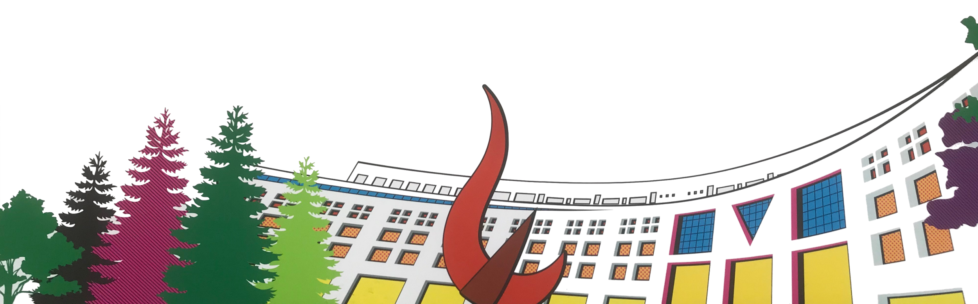

ML/DL for Everyone with
Lecture 4: Back-propagation
Sung Kim <hunkim+ml@gmail.com> HKUST
Code: https://github.com/hunkim/PyTorchZeroToAll
Slides: http://bit.ly/PyTorchZeroAll

Slide 2

Call for Comments
Please feel free to add comments directly on these slides.
Other slides: http://bit.ly/PyTorchZeroAll
Picture from http://www.tssablog.org/archives/3280

Slide 3
ML/DL for Everyone with
Lecture 4: Back-propagation
Sung Kim <hunkim+ml@gmail.com> HKUST
Code: https://github.com/hunkim/PyTorchZeroToAll
Slides: http://bit.ly/PyTorchZeroAll

Slide 4
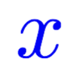
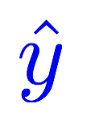

Computing gradient in simple network
Linear
# compute gradient
def gradient(x, y): # d_loss/d_w
return 2 * x * (x * w - y)
Notes:
loss = (\hat{y}-y)^2 = (x*w-y)^2
\frac{\partial{loss}}{\partial{w}}=?

Slide 5
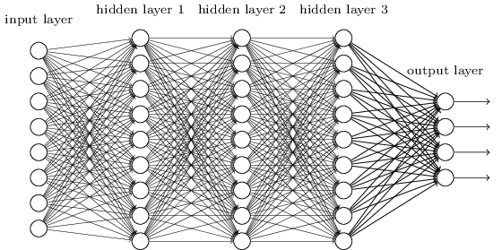
Complicated network?
Notes:
loss = (\hat{y}-y)^2 = (x*w-y)^2
\frac{\partial{loss}}{\partial{w}}=?

Slide 6
Better way? Computational graph + chain rule
Notes:
loss = (\hat{y}-y)^2 = (x*w-y)^2
\frac{\partial{loss}}{\partial{w}}=?

Slide 7
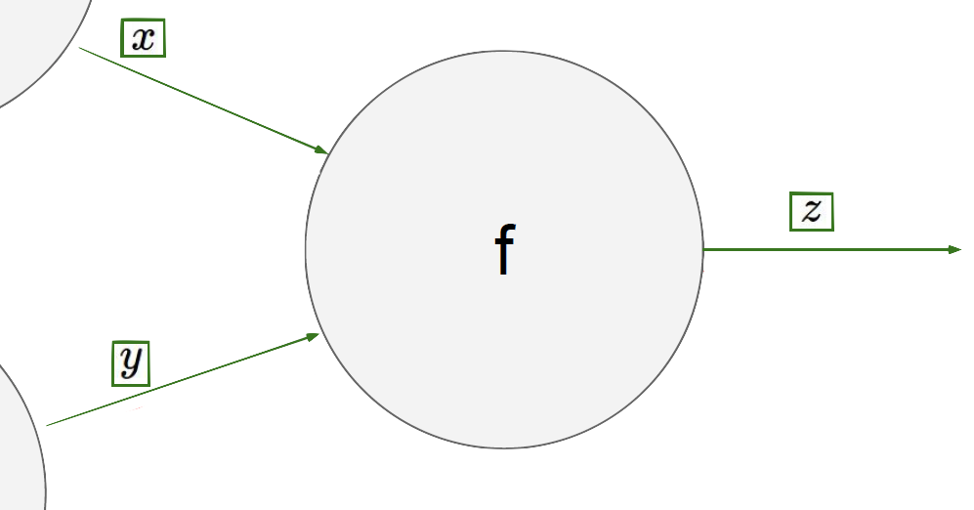
Chain rule

Slide 8
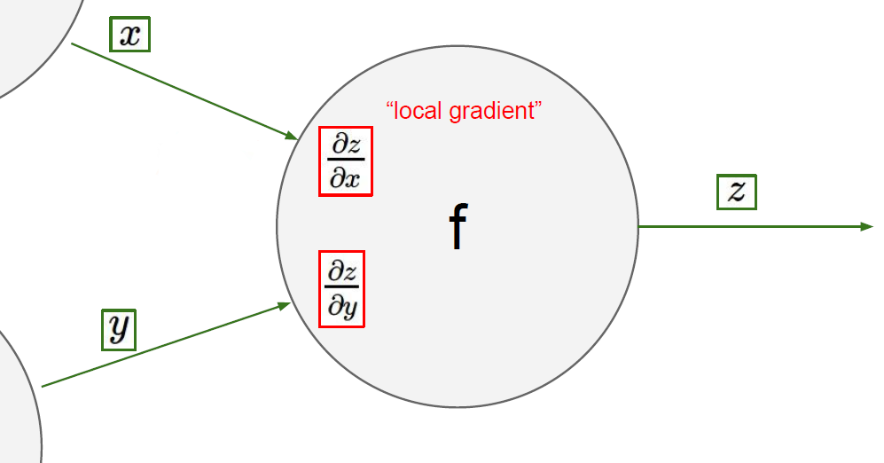
Chain rule

Slide 9
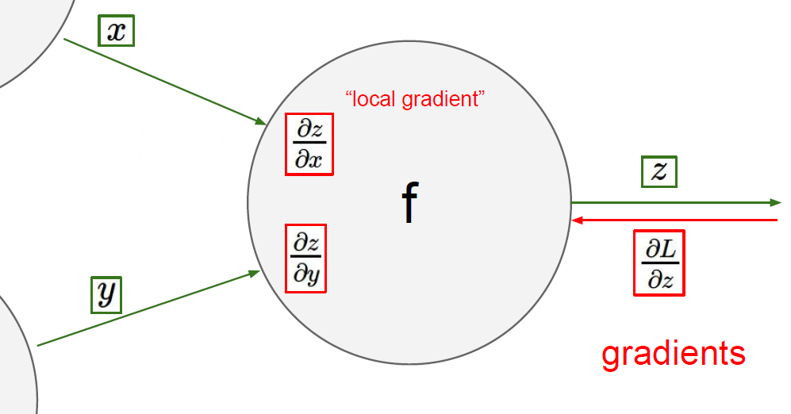

Chain rule

Slide 10
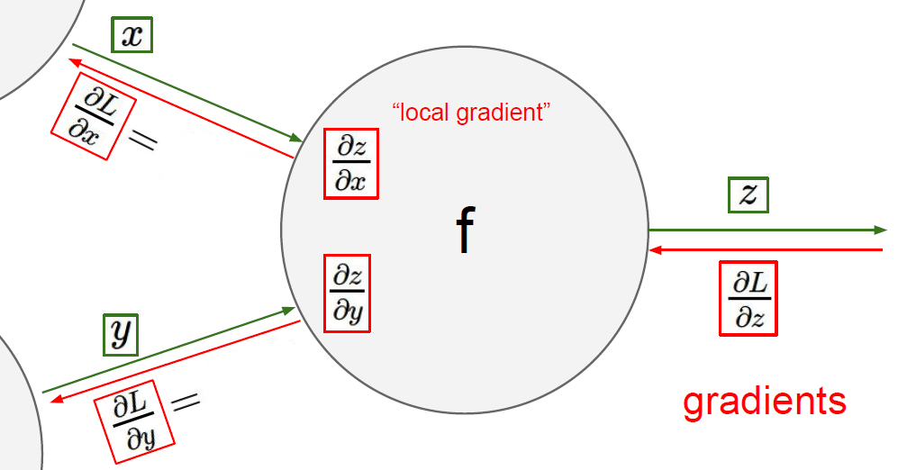
Chain rule

Slide 11

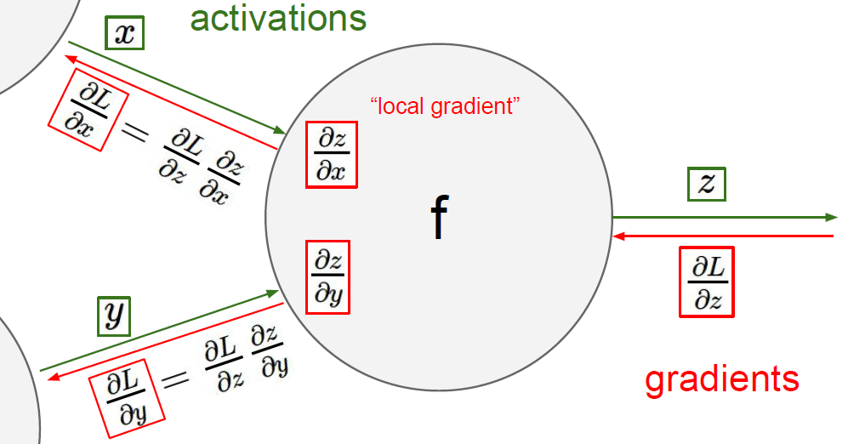
Chain rule

Slide 12
f=*
*

Slide 13

f=*
Forward pass x= 2, y = 3
*

Slide 14

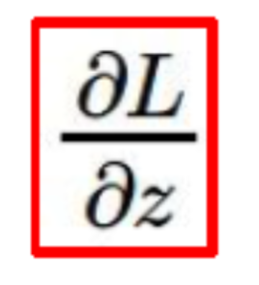
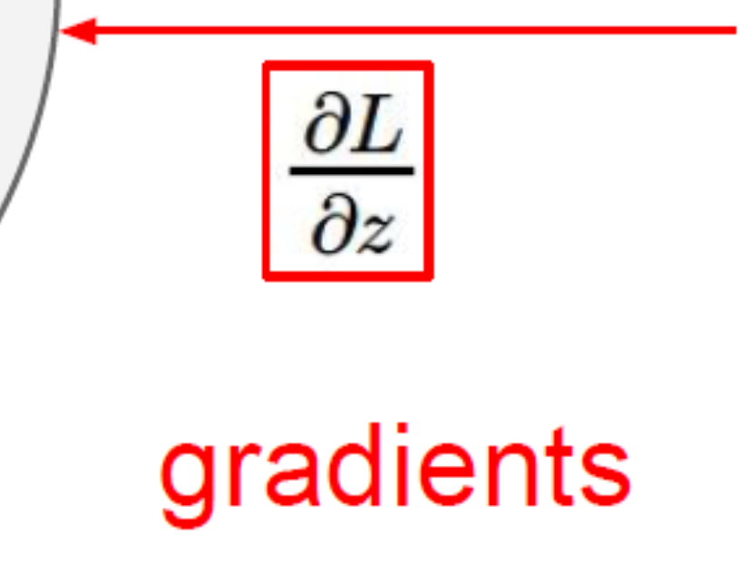
Backward propagation
= 5 is given.
= 2
*
= 6
= 5
= 3

Slide 15
Backward propagation
= 5 is given.
= 2
= y
*
= 6
= x
= 5
= 3

Slide 16
Backward propagation
= 5 is given.
= 2
= y
*
= 6
= 5*y = 15
= x
= 5
= 3
= 5*x = 10

Slide 17

Computational graph
Notes:
loss = (\hat{y}-y)^2 = (x*w-y)^2
\frac{\partial{loss}}{\partial{w}}=?

Slide 18
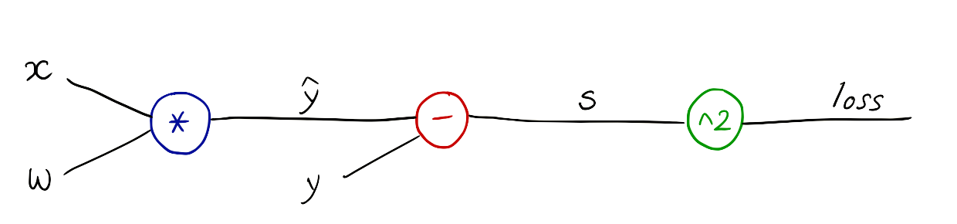
Computational graph
Notes:
loss = (\hat{y}-y)^2 = (x*w-y)^2
\frac{\partial{loss}}{\partial{w}}=?

Slide 19
Computational graph
Notes:
loss = (\hat{y}-y)^2 = (x*w-y)^2
\frac{\partial{loss}}{\partial{w}}=?

Slide 20
Computational graph
Notes:
loss = (\hat{y}-y)^2 = (x*w-y)^2
\frac{\partial{loss}}{\partial{w}}=?
\frac{\partial{z-y}}{\partial{}z}=1

Slide 21
Forward pass x=1, y = 2 where w=1
Notes:
loss = (\hat{y}-y)^2 = (x*w-y)^2
\frac{\partial{loss}}{\partial{w}}=?

Slide 22




Backward propagation
=1
=1
=-1
=1
=1
=2
Notes:
\frac{\partial{\hat{y}-y}}{\partial{\hat{y}}}=1

Slide 23




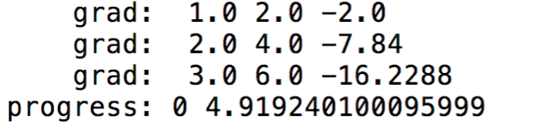

Backward propagation
=1
=1
=-1
=1
=1
=2
Notes:
\frac{\partial{\hat{y}-y}}{\partial{\hat{y}}}=1
\frac{\partial{loss}}{\partial{s}}=2s=-2
—-
\frac{\partial{loss}}{\partial{\hat{y}}}
=
\frac{\partial{loss}}{\partial{s}}
\frac{\partial{s}}{\partial{\hat{y}}}
=-2*1=-2
—-

Slide 24
Exercise1: x = 2, y=4, w=1
=2
=2
=-2
=4
=1
=4
Notes:
\frac{\partial{\hat{y}-y}}{\partial{\hat{y}}}=1

Slide 25

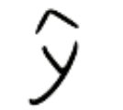

Exercise 2: x = 1, y=2, w=1, b=2
+
b
Notes:
loss = (\hat{y}-y)^2 = (x*w-y)^2
\frac{\partial{loss}}{\partial{w}}=?

Slide 26

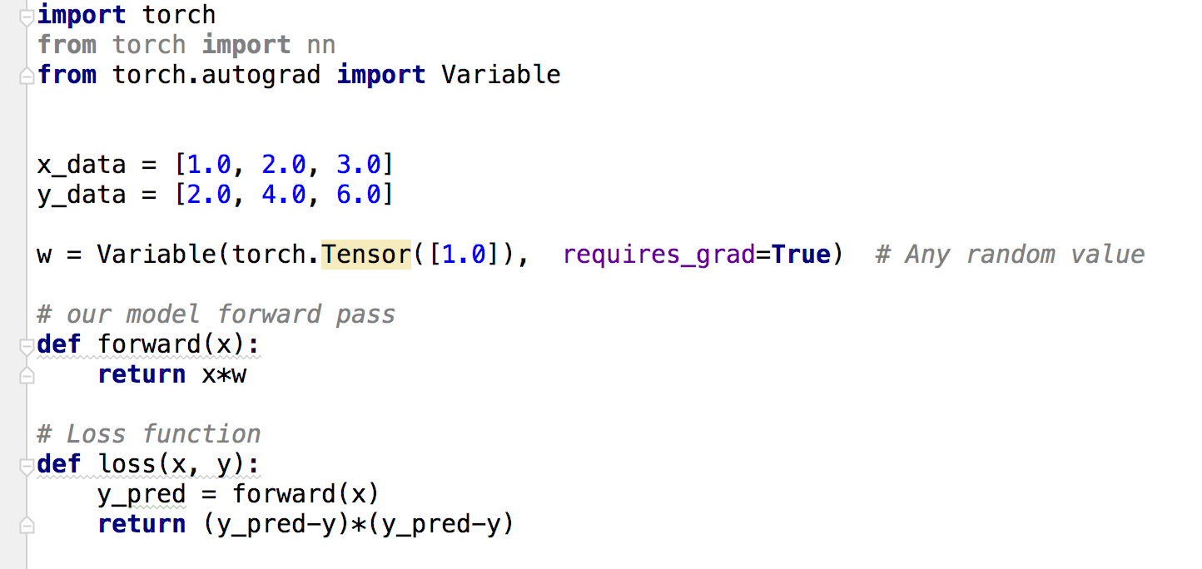
Data and Variable
http://pytorch.org/docs/master/notes/autograd.html?highlight=variable

Slide 27
Data and Variable
http://pytorch.org/docs/master/notes/autograd.html?highlight=variable

Slide 28
Model and Loss

Slide 29
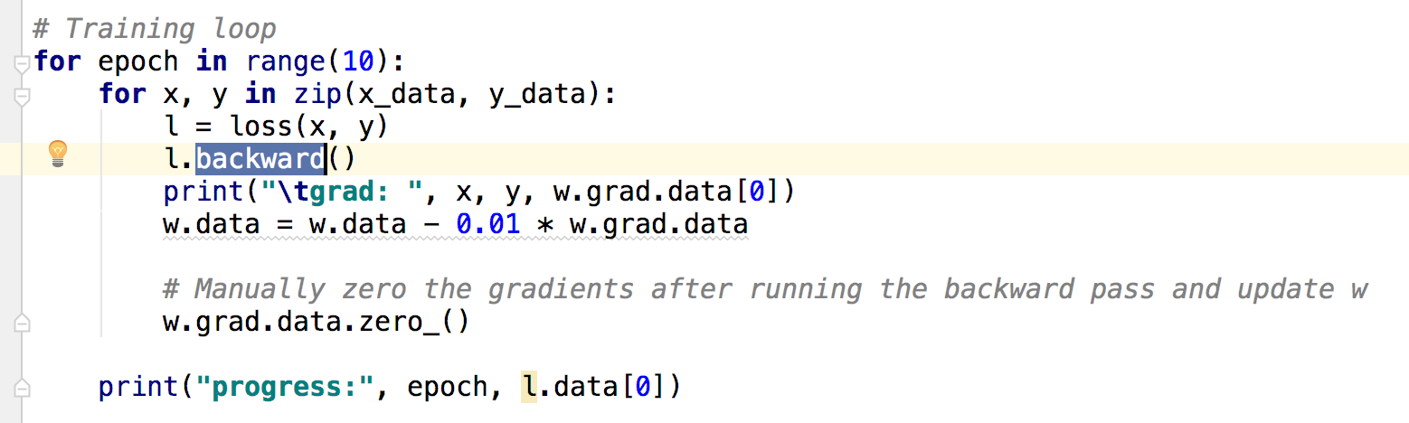
Training: forward, backward, and update weight

Slide 30
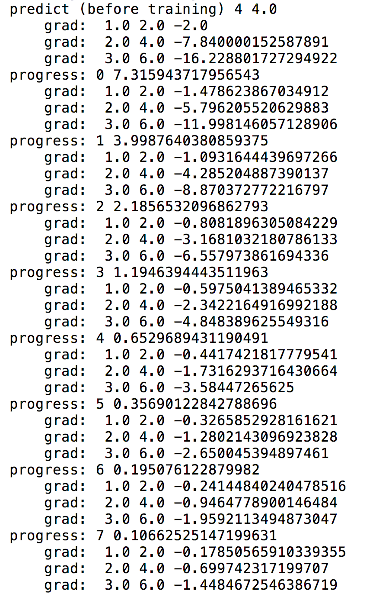
Output

Slide 31
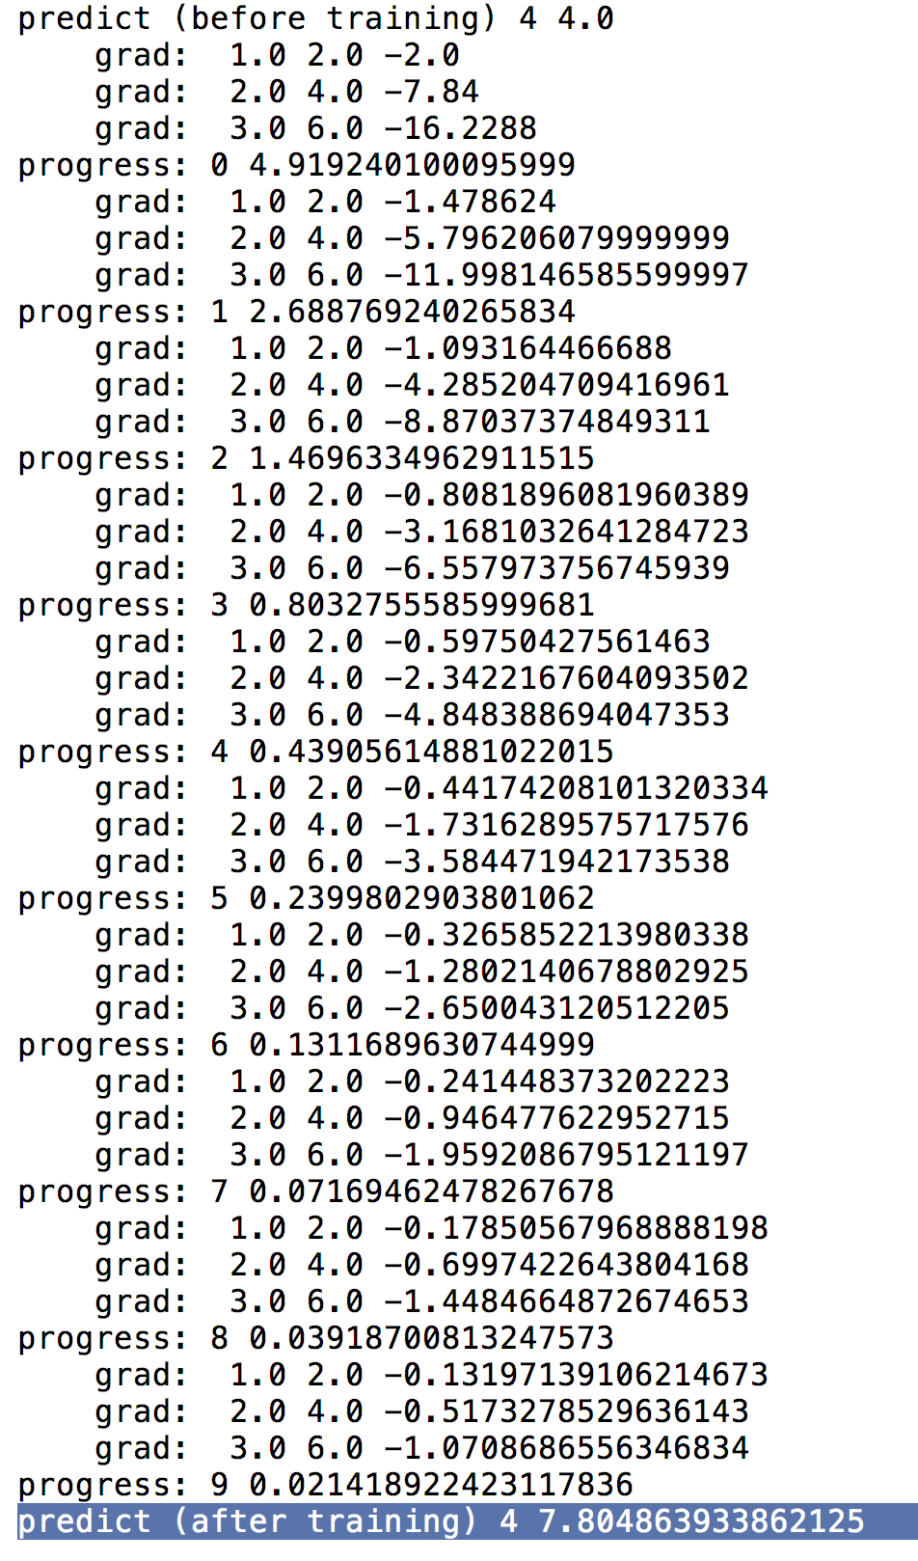
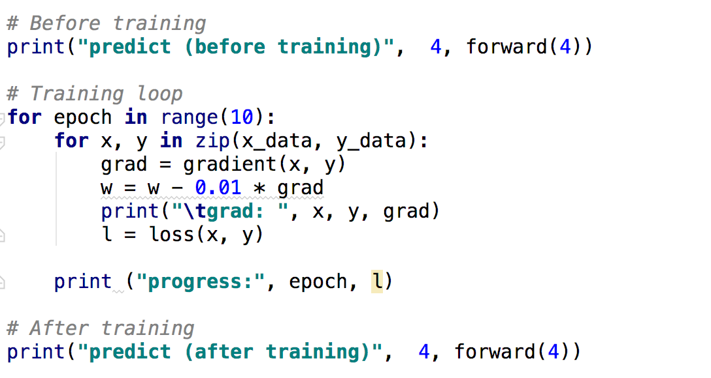
Output
(from numeric gradient computation)

Slide 32
Output
(from numeric gradient computation)
Output
(computational graph)

Slide 33
PyTorch forward/backward
Notes:
loss = (\hat{y}-y)^2 = (x*w-y)^2
\frac{\partial{loss}}{\partial{w}}=?

Slide 34
Forward pass
w = Variable(torch.Tensor([1.0]), requires_grad=True) # Any random value l = loss(x=1, y=1)
=1
=1
=-1
=1
=1
=2
Notes:
\frac{\partial{\hat{y}-y}}{\partial{\hat{y}}}=1

Slide 35
Back propagation
l.backward()
# Manually zero the gradients after running the backward pass and update w w.grad.data.zero_()
=2
=2
=-2
=4
=1
=4
w.grad
Notes:
\frac{\partial{\hat{y}-y}}{\partial{\hat{y}}}=1

Slide 36
Weight update (step)
w.data = w.data - 0.01 * w.grad.data
=2
=2
=-2
=4
=1
=4
w.grad
Notes:
\frac{\partial{\hat{y}-y}}{\partial{\hat{y}}}=1

Slide 37


Lecture 5:
Linear regression
in the PyTorch way

